Slide 1
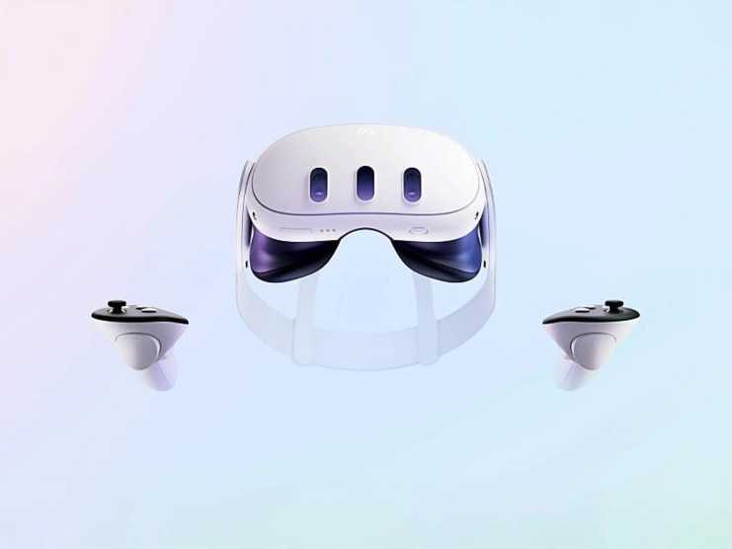
Meta Quest 3
The Meta Quest 3 comes with two Touch Plus controllers. (see Figure 1).
Problem: Need for Meta Quest 3
An affordable Meta Quest 3 is needed with a camera and sensors to enhance the experience in gaming and education.
Solution: Setting up the Meta Quest 3
Criteria
Battery Life and Charging
Cost
Display & Visual Quality
References
[1] B. Ashworth, "The Leaked Quest 3 Headset Video Teases Meta's VR Ambitions," wired.com, 23 August 2023. [Online]. Available: https://www.wired.com/story/meta-quest-3-headset-video-leak/. [Accessed 11 February 2025].
Figure 1: Meta Quest 3 [1]

